Slide 1
Back-To-School Night
We will begin at 6:00. Please mute your mic and use the chat box for questions.
Mrs. Gonzales
5th Grade 2020-2021

Slide 2
About Me
I grew up in Chino and Chino Hills
BA and MA from University of La Verne
18th Years of teaching in CVUSD
My 3 boys attend Litel
Contact info
Email: amanda_gonzales@chino.k12.ca.us
Remind: text @3ad7gkb to the number 81010
909) 591-1336 ext. 5913

Slide 3
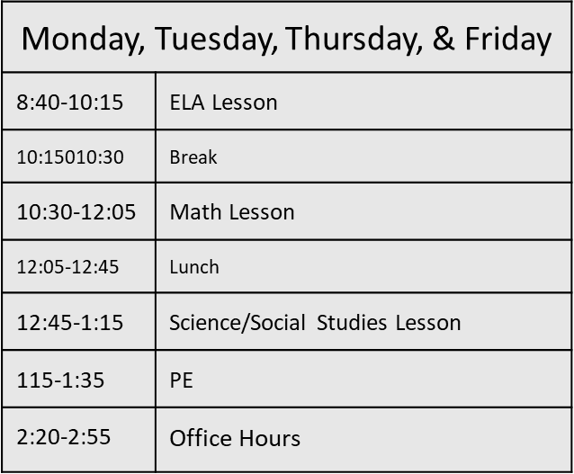
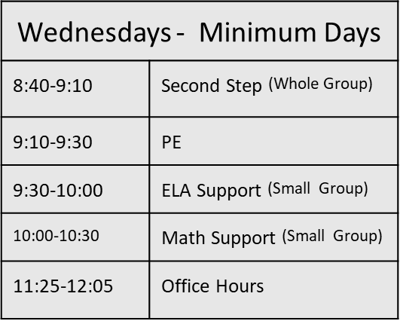
Schedule 5th Grade requires 240 minutes of daily instruction which includes synchronous and asynchronous work.
*150-210 minutes of asynchronous work will be given outside of live sessions on mini days. This will include 30 minutes of PE.

Slide 4
Office Hours .
During these hours, I will be available immediately via email and remind. You can also contact me ahead of time to schedule a Google Meet during this time.
Monday, Tuesday, Thursday, Friday 2:20-2:55
Wednesday 11:25-12:05

Slide 5
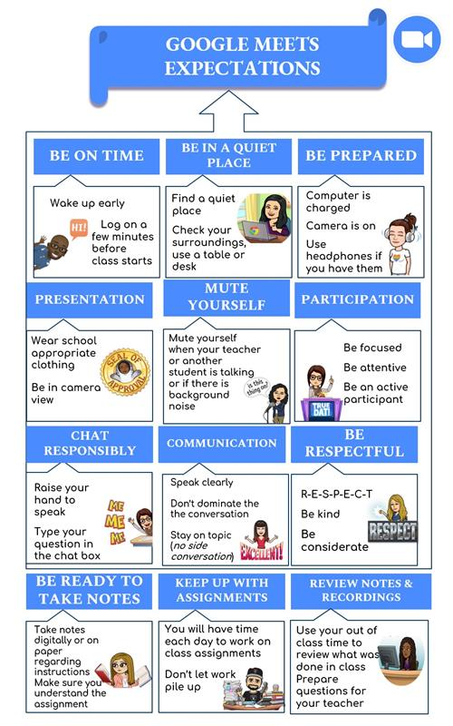
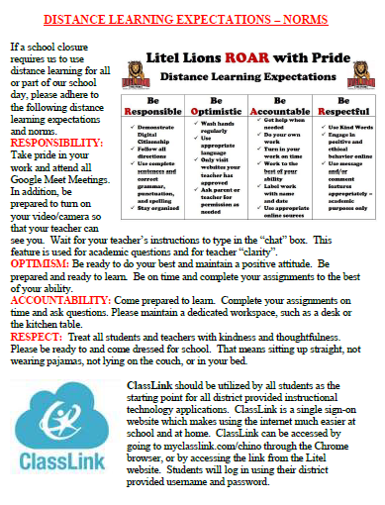
Expectations

Slide 6
Curriculum
The curriculum planned for the year is aligned with Common Core State Standards (ELA and Math)and the California Content Standards (all others).
Complete listing of standards can be found on California Department of Education Website
https://www.cde.ca.gov/be/st/ss/index.asp
**Emphasis on the Essential Standards**

Slide 7
Reading
We will be using the Wonders Textbook, Thinking Maps, and Icons of Depth and Complexity to learn reading skills and strategies
Students will be reading in all areas of the curriculum
Use of Supplemental Reading Materials
Core Literature
AR all students are required to reading 2 chapter books a month. If the book is over 300 pages, it can count as two books. Each test needs to be completed with 80% correct

Slide 8
Math
Today’s world includes new types of careers in the applied math and sciences. Children now need to understand the why behind math concepts and be able to explain their processes.
In order to set students up to be successful in junior high, high school, and college, they need a solid foundation as they learn number sense and basic concepts in the early grades.
This year, students will be learning several different approaches to solve the same problem. They will be expected to explain their reasoning and show the many ways an answer can be determined or written.
Math Talks and Icons that promote mathematical reasoning, problem solving, and communication
Student work needs to be shown on all homework or on a separate sheet of paper. Homework is assigned daily except for test days.

Slide 9
Writing
Heavy use of Thinking Maps
A variety of Genres will be covered (Narrative, Informational, Opinion)
Emphasis on building structure and the use of strategies that add to the effectiveness of writing

Slide 10
Second Step
Second Step is a program rooted in social-emotional learning (SEL).
These are curriculum-based lessons.
District wide – PBIS
Positive Behavioral Interventions & Supports
*Responsible, Respectful, and Safe

Slide 11
Social Studies
Reading and writing skills emphasized and practiced
Science…transition to NGSS
STEM Projects at home
Social Studies will cover US History

Slide 12
Physical Education
We will encourage cardiovascular fitness and student involvement
Brain Breaks
200 minutes every 2 weeks

Slide 13
Performing Arts
-Art, music, and oral presentation assignments usually correspond with other topics that are in the curriculum
-Band: I will pass along any information I get on this topic

Slide 14
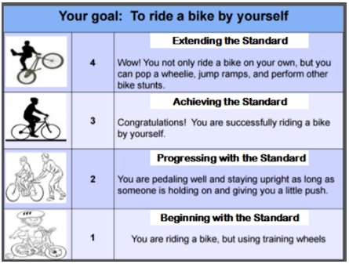
Syllabus

Slide 15
Grading
Grades are based on accuracy and quality in mastering the CCSS.
Various assessments will be given to assess mastery of each standard on the following scale:
4 – Extending the Standard
3 – Achieving the Standard
2 – Progressing Toward the Standard
1 – Beginning with the Standard
Please check in on your child’s Google Classroom, Savvas, and Wonders accounts to view progress. I will also send progress reports at the halfway point of each trimester.

Slide 16
Google Classroom
Please check your student’s google classroom often.
Missing work- light gray turned in dark gray not turned in
Grades- under classwork in Google classroom click on View your Work

Slide 17
Homework
Students’ responsibilities for homework are:
1. All assignments will be completed and turned in on time, at the start of the day.
2. Students will turn in homework that is neatly done.
Students are responsible for making up the work if absent. Make-up work is due equal to the number of days absent. Tests are given two days after returning, or earlier if desired.
With the exception of Wednesdays, most “homework” is work that was not completed during our live learning sessions.

Slide 18
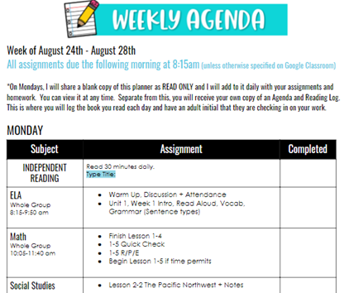
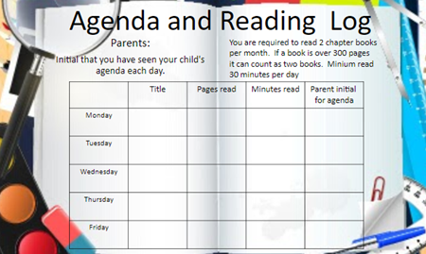
Homework
At the end of each day, I will
update our VIEW ONLY agenda
that students can access on
Google Classroom.

Slide 19
Attendance
Students are expected to be at school. Each day of school should provide an important learning experience, and if your child(ren) are not here, they miss the learning continuity.
Board Policy requires a parent verification of each absence within 5 school days of the student’s return to school. On the sixth day, the absence becomes unverified and cannot be changed. State law requires that each absence be cleared.
You may clear an absence by calling the school messaging service or by reporting the absence online at your student’s home school.
Please contact the office for reporting absences. Contacting the teacher about an absence is not the same as clearing the absence with the office.

Slide 20
AERIES COMMUNICATION
Aeries Communications is CVUSD's communication tool. Its easy-to-use system means parents will receive timely, relevant messages from your child’s school.
These messages can be delivered in several forms, and parents may choose whichever is the most useful, practical version.
Email (default) Phone (voice) (default) SMS text
Parents must provide email address when they register.
If the contact number provided does not accept text messages (landline) you will not be able to receive texts.

Slide 21
Other
Virtual Parent-Teacher conferences are September 21-25. I will send out a link to sign up as the time gets closer.
Please check Classroom website regularly.
Procedures are constantly fluid as we learn what works and what doesn’t in remote learning. I appreciate your patience and support.
If you have not picked up your back to school packets from the school office please do so soon

Slide 22
PTA
One of the vital reasons for a school’s success is the amount of parent involvement and support for school activities. The PTA coordinates parent involvement and support. The school staff and PTA work as a team to decide what is best for the students with the active support of parents.
Please consider volunteering for at least one event or program this year.

